Slide 1

Topic: 2nd Law of Thermodynamics
Lecture – 8
Disclaimer:
The study materials/presentations are solely meant for academic purposes and they can be reused, reproduced, modified, and distributed by others for academic purposes only with proper acknowledgements.

Slide 2
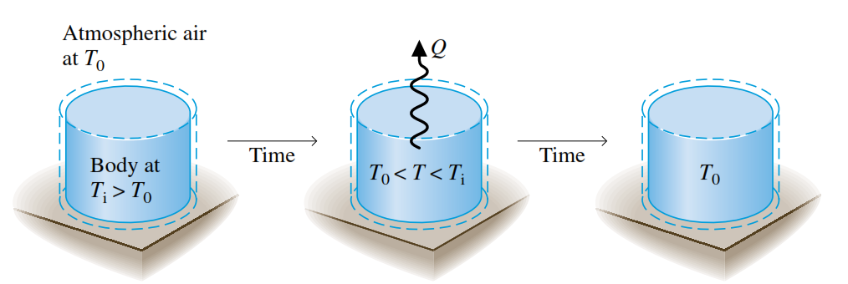
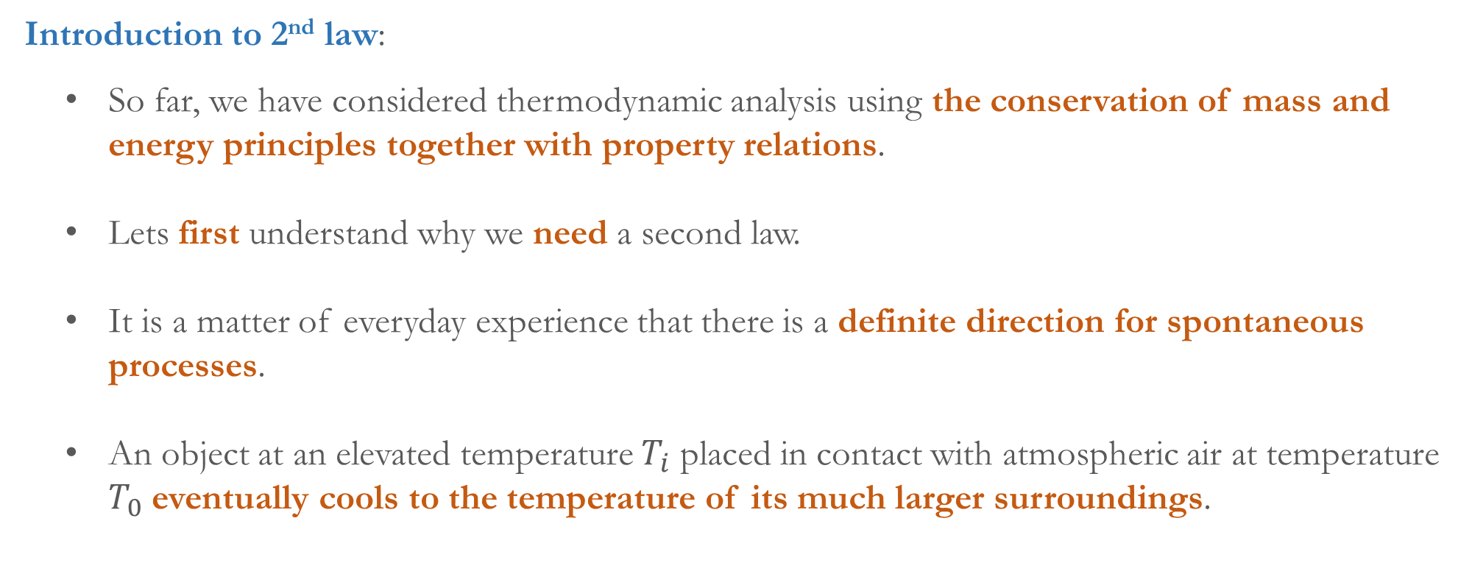
  Introduction to 2nd law:
  So far, we have considered thermodynamic analysis using the conservation of mass and energy principles together with property relations.
  Lets first understand why we need a second law.
  It is a matter of everyday experience that there is a definite direction for spontaneous processes.
  An object at an elevated temperature $T_{i}$ placed in contact with atmospheric air at temperature $T_{0}$ eventually cools to the temperature of its much larger surroundings.

Slide 3
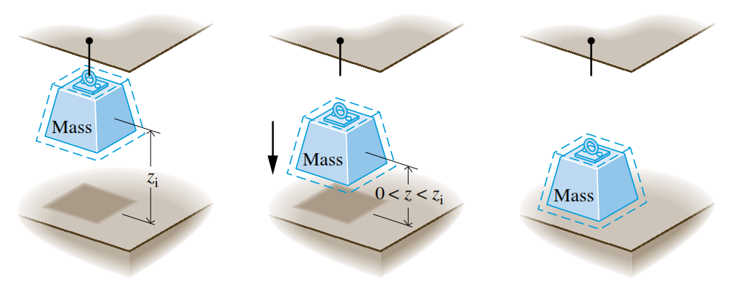
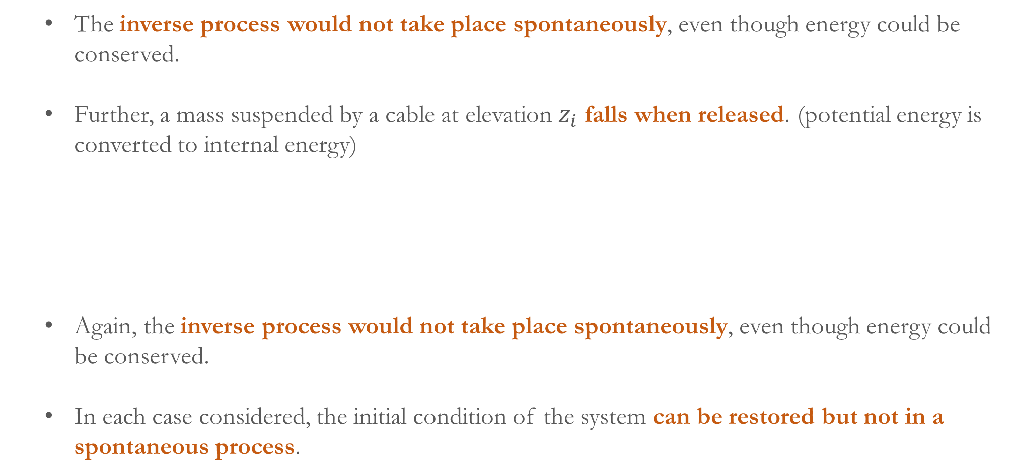
  The inverse process would not take place spontaneously, even though energy could be conserved.
  Further, a mass suspended by a cable at elevation $z_{i}$ falls when released. (potential energy is converted to internal energy)
  Again, the inverse process would not take place spontaneously, even though energy could be conserved.
  In each case considered, the initial condition of the system can be restored but not in a spontaneous process.

Slide 4
  Therefore, a fuel or electrical input normally would be required for the auxiliary devices to function (to reheat the object or to lift the mass).
  Therefore, a permanent change in the condition of the surroundings would result.
  This indicates that not every process consistent with the principle of energy conservation can occur.
  An energy balance alone neither predicts the preferred direction nor permits the processes that can occur to be distinguished from those that cannot.
  Therefore, a guiding principle is necessary. This is provided by the second law.
  Further, systems tend to undergo spontaneous changes until a condition of equilibrium is achieved, both internally and with their surroundings.

Slide 5
  However, only energy conservation principle would be insufficient for determining the final equilibrium state. This is provided by the second law.
  When an imbalance exists between two systems, there is an opportunity for developing work.
  The work is otherwise lost if the systems are allowed to come into equilibrium in an uncontrolled way.
  So we can pose two questions:
    (1) What is the theoretical maximum value for the work that could be obtained?
    (2) What are the factors that prevent from realizing the maximum value?
    The obtained work cannot be unlimited. Even the best devices would be subject to factors such as friction that would prevent attaining the theoretical maximum work.

Slide 6
    The second law of thermodynamics provides the means for determining the theoretical maximum and quantifying the factors that prevent from attaining the maximum.
    Summarizing the important aspects or uses of 2nd law of thermodynamics
      Predicting the direction of processes.
      Establishing conditions for equilibrium.
      Determining the best theoretical performance.
      Evaluating quantitatively the factors that preclude the attainment of the best theoretical performance level.
    Statements of 2nd Law:
    Three alternative statements of the second law of thermodynamics are there, namely, (1) Clausius, (2) Kelvin–Planck, and (3) Entropy statements. The Clausius and Kelvin–Planck statements are traditional formulations of the second law.

Slide 7
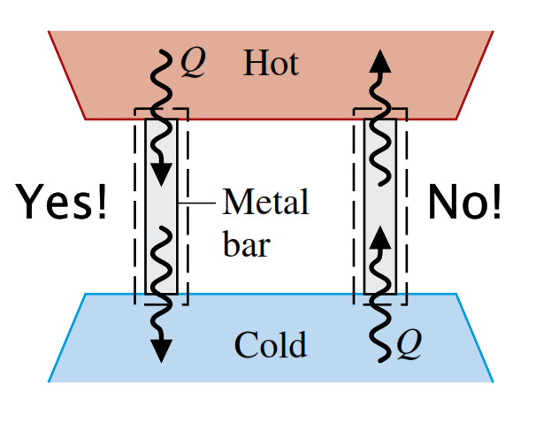
    Clausius Statement of the Second Law:
    This states that: It is impossible for any system to operate in such a way that the sole result would be an energy transfer by heat from a cooler to a hotter body.
    This does not rule out the possibility of transferring energy by heat from a cooler body to a hotter body.
    However, when a heat transfer from a cooler body to a hotter body occurs, there must be other effects within the system, its surroundings, or both.
    Example: The refrigerators are driven by electric power from their surroundings to operate.
    Therefore, the statement implies that it is impossible to construct a refrigeration cycle that operates without a power input.

Slide 8
    A thermal reservoir, or simply a reservoir, is a special kind of system that always remains at constant temperature even though energy is added or removed by heat transfer.
    A reservoir is an idealization, but such a system can be approximated in a number of ways.
    For examples, earth’s atmosphere, large bodies of water (lakes, oceans), a large block of copper, and a system consisting of two phases at a specified pressure.
    Kelvin–Planck Statement of the Second Law:
    This states that: It is impossible for any system to operate in a thermodynamic cycle and deliver a net amount of energy by work to its surroundings while receiving energy by heat transfer from a single thermal reservoir.
    Again this law does not rule out the possibility of a system developing a net amount of work from a heat transfer drawn from a single reservoir.

Slide 9
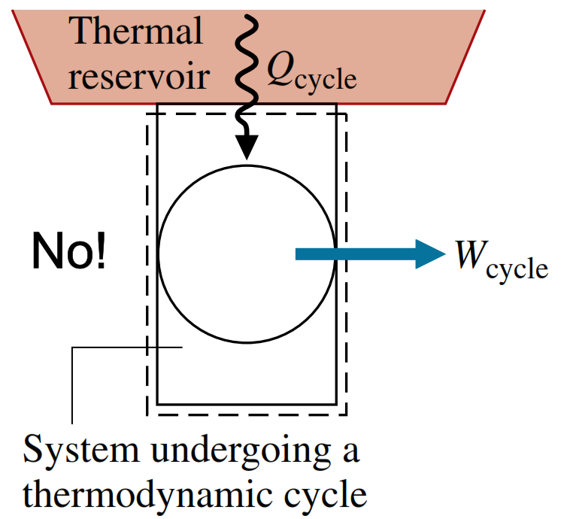
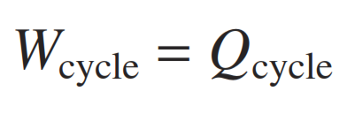
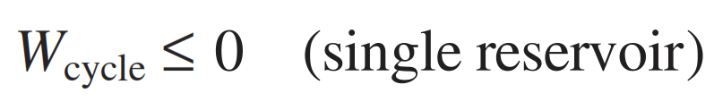
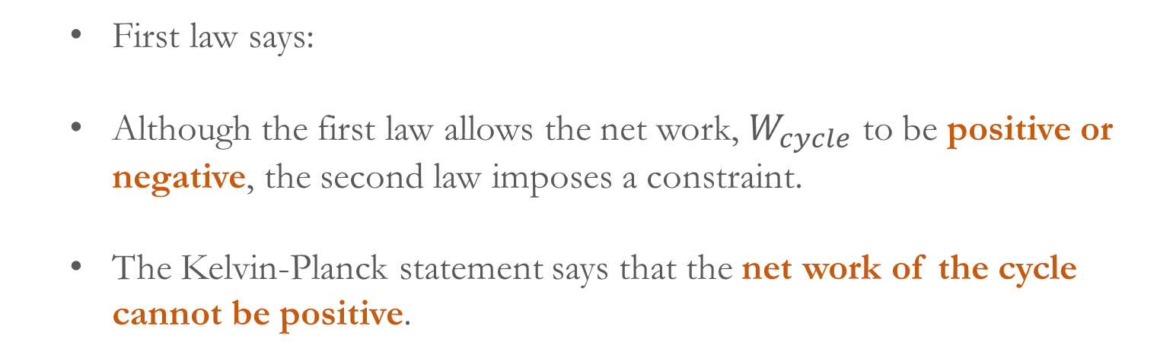
    It only denies this possibility if the system undergoes a thermodynamic cycle.
    Let us study a system undergoing a cycle while exchanging energy by heat transfer with a single reservoir.
    First law says:
    Although the first law allows the net work, $W_{cycle}$ to be positive or negative, the second law imposes a constraint.
    The Kelvin-Planck statement says that the net work of the cycle cannot be positive.
    Thus, the analytical form of the Kelvin–Planck statement is
    The equivalence of the Clausius and Kelvin–Planck statements can be shown. (Self Study)

Slide 10
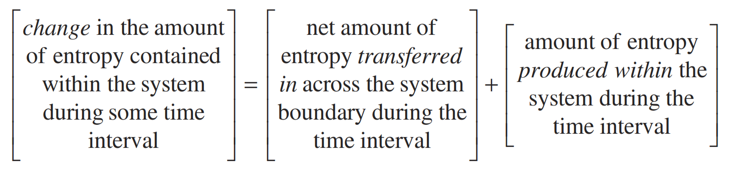
    Entropy Statement of the Second Law:
    Entropy is another important extensive property. Similar to mass and energy the entropy is accounted for by an entropy balance.
    Like mass and energy, entropy can be transferred across the system boundary.
    For closed systems, there is a single means of entropy transfer, namely, entropy transfer accompanying heat transfer.
    For control volumes, entropy also is transferred in and out by streams of matter.

Slide 11
    Unlike mass and energy, which are conserved, entropy is produced (or generated) within systems whenever irreversibilities such as friction are present.
    The entropy statement says that: It is impossible for any system to operate in a way that entropy is destroyed.
    It follows that the entropy production term may be positive or zero but never negative.
    Thus, entropy production is an indicator of whether a process is possible or impossible.
    Irreversible and reversible processes:
    A process is called irreversible if the system and all parts of its surroundings cannot be exactly restored to their respective initial states after the process has occurred.
    A process is reversible if both the system and surroundings can be returned to initial states.

Slide 12
    Therefore, the second law can be used to determine whether a given process is reversible or irreversible.
    The Clausius statement of the second law says that any process involving spontaneous heat transfer from a hotter body to a cooler body is irreversible.
    Irreversible processes normally include
      Heat transfer through a finite temperature difference
      Inelastic deformation
      Magnetization or polarization with hysteresis
      Spontaneous mixing of matter
      Friction
      Electric current flow through a resistance

Slide 13
    Essentially, all actual processes are irreversible.
    For many analyses it is convenient to divide the irreversibilities present into two classes.
    Internal irreversibilities are those that occur within the system. External irreversibilities are those that occur within the surroundings, often the immediate surroundings.
    Engineers should be able to recognize irreversibilities, evaluate their influence, and develop practical means for reducing them.
    However, certain systems, such as brakes, rely on the effect of friction or other irreversibilities in their operation.
    Please note that reversible processes are purely hypothetical. That is reversible processes do not occur.

Slide 14
    A reversible process is the limiting case as irreversibilities, both internal and external, are reduced further and further.
    An internally reversible process is one for which there are no irreversibilities within the system. Irreversibilities may be located within the surroundings, however.

